Slide 1

Kohler Product Proposal
For Shangri-La Melbourne
Nov 2023

Slide 2
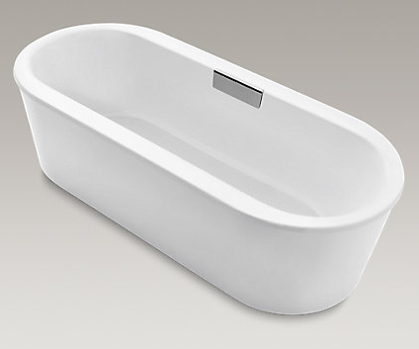
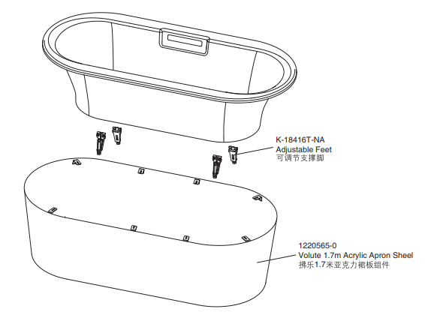
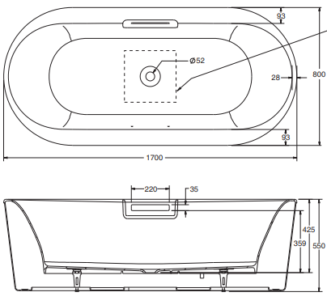
Volute Freestanding Cast Iron Bath
Volute 1.7m Freestanding Cast Iron Bath
Size: 1700x800x550mm
Product Code: 99311T-0
Gross Weight: 170KG
Excellent heat retention with quite performance
Slip Resistance Surface

Slide 3
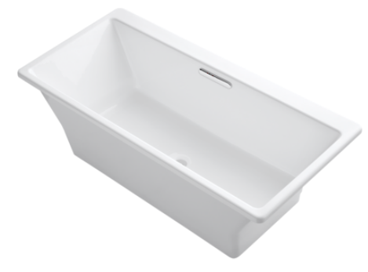
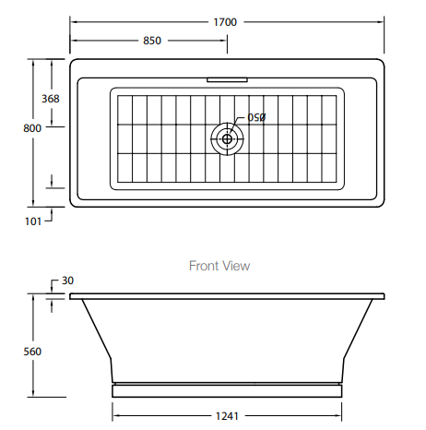
Evok Freestanding Cast Iron Bath
Evok 1.7m Freestanding Cast Iron Bath
Size: 1700x800x560mm
Product Code: 98204-0
Gross Weight: 165.5KG
Excellent heat retention with quite performance
Slip Resistance Surface

Slide 4
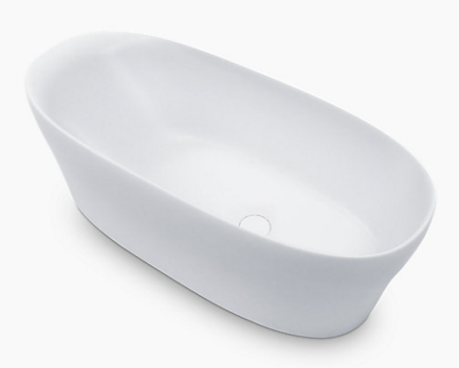
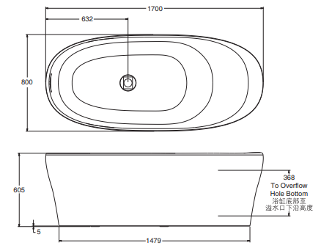
Karing Freestanding Lithocast Bath
Karing 1.7m Freestanding Lithocast Bath
Size: 1700x800x605mm
Product Code: 20374A-0
Gross Weight: 140KG
Quality combination of pure acrylic and proprietary minerals to produce a durable bath resistant to tarnish
Extraordinary design with outstanding innovation to create a premium look
Integral moulding technology to create a seamless design with enhanced sturdiness and lasting beauty
Ergonomic design provides the most comfortable environment for the user to rest

Slide 5
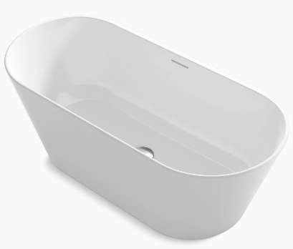
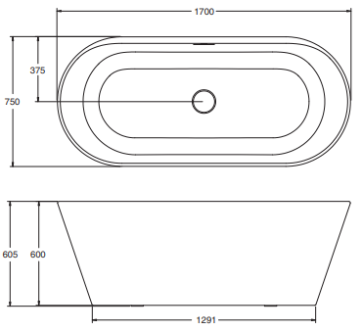
Evok Freestanding Lithocast Bath
Evok 1.7m Freestanding Lithocast Bath
Size: 1700x750x605mm
Product Code: 21095A-0
Gross Weight: 175KG
The bath has contemporary design without sacrificing comfort
Pure acrylic and Aluminum Hydroxide prevent yellowing and are free of radiation
The aluminum hydroxide material is resistant to stain and corrosion, and can be repaired by grinding

Slide 6
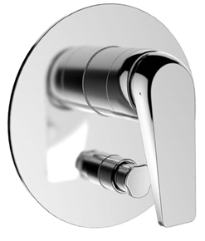
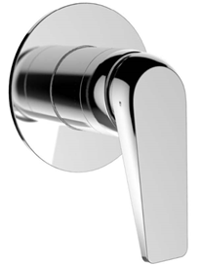
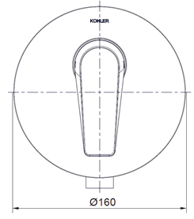
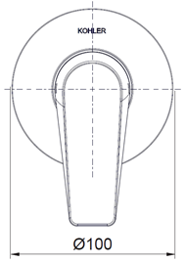
Avid Shower Mixer – Slim Trim
Product Code:
21392T-4-CP (non-diverter version) to use with 78981T-BDR-NA
21391T-4-CP (Diverter Version) to use with
78980T-BDR-CP

Slide 7
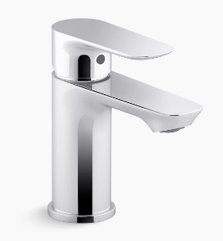
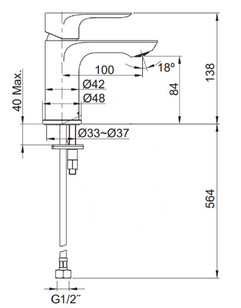
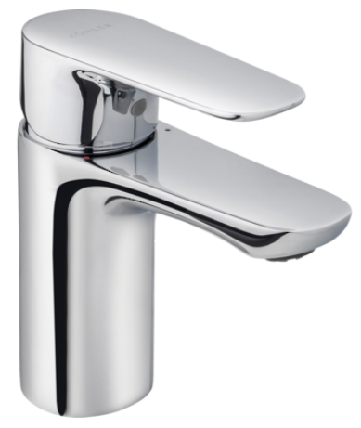
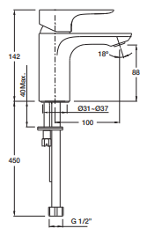
Aleo Slim Basin Mixer vs. Aleo Basin Mixer
Aleo Slim Basin Mixer – (25102T-4ND-CP)
Aleo Basin Mixer – (72275T-4ND-CP)

Slide 8
Aleo Slim Basin Mixer vs. Aleo Basin Mixer
Aleo Slim Basin Mixer – (25102T-4ND-CP)
Aleo Basin Mixer – (72275T-4ND-CP)

